Slide 1
How I fully compromised the “most advanced code execution system in the world”
Daniel Cooper

Slide 2

DANIEL COOPER
Security Consultant
at Tanto Security
Occasionally plays on CTFs for teams such as Blitzkrieg and Emu Exploit
(under the username ssparrow)

Slide 3
Story Time

Slide 4
Competitive Programming Contests
One of my friends was trying to make a Contest Management System as a side project (For competitive programming competitions)
I like to hack stuff
So I was looking through his code and saw that he ran his code inside a sandbox called Judge0
I wondered how Judge0 implements its security

Slide 5
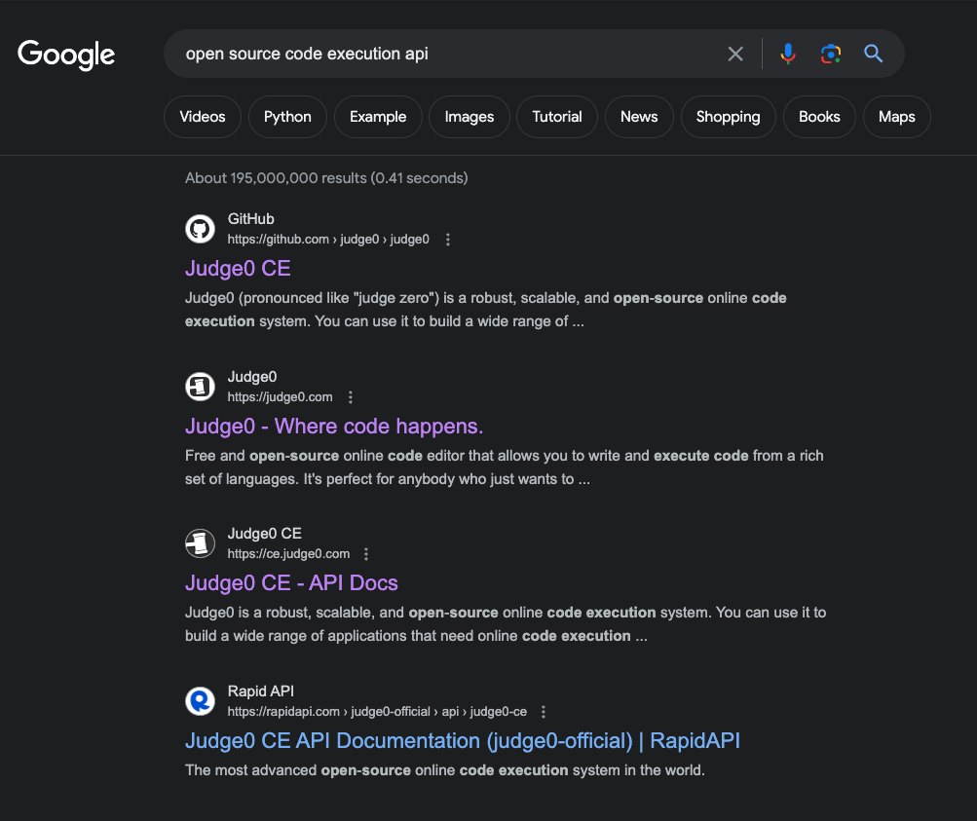
Judge0
Competitive Programming Contests
How to offer RCE securely? 🤔
Difficult problem so people want to use a pre-existing solution
Judge0 has had a lot of thought put into this
They wrote a research paper on why it’s secure (I would rather look at the code myself though)

Slide 6
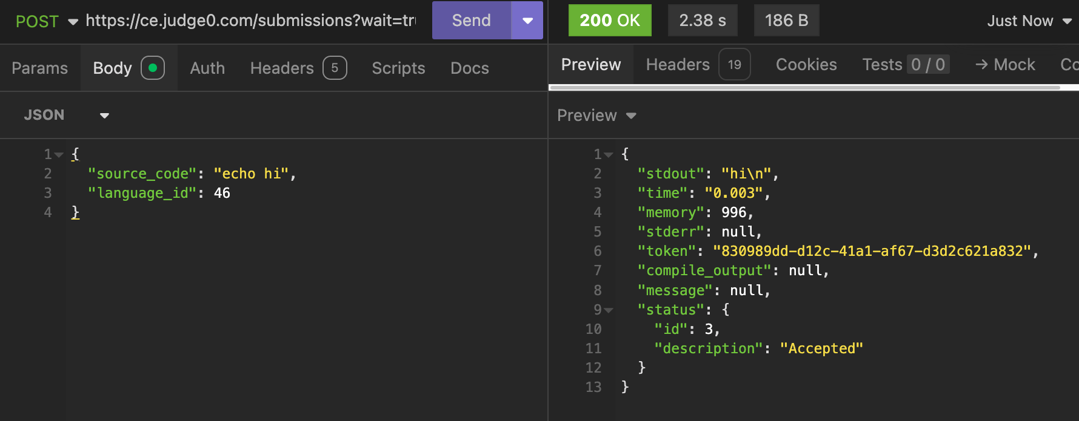
How does Judge0 work?
Submit code with HTTP request, get stdout and other metrics

Slide 7
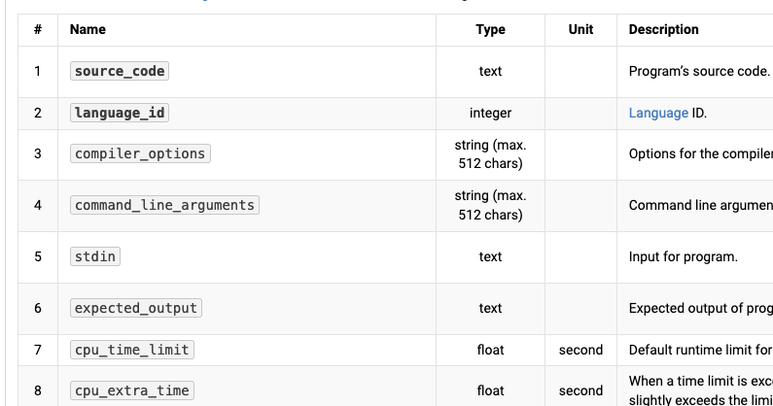
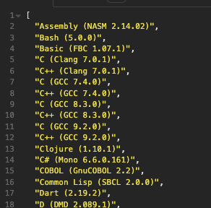
Lots of features and supported languages
The idea of Judge0 is simple, but it supports a lot of options.
Around 80 languages and 30 runtime options

Slide 8
My plan
Find out how Judge0 runs the code you provide it
What is preventing basic attacks? (eg file traversal, SSRF)
Is it possible for submissions to interact with each other concurrently?
Any issues an attacker could use to cheat in a programming contest? (impact?)

Slide 9
Code overview

Slide 10
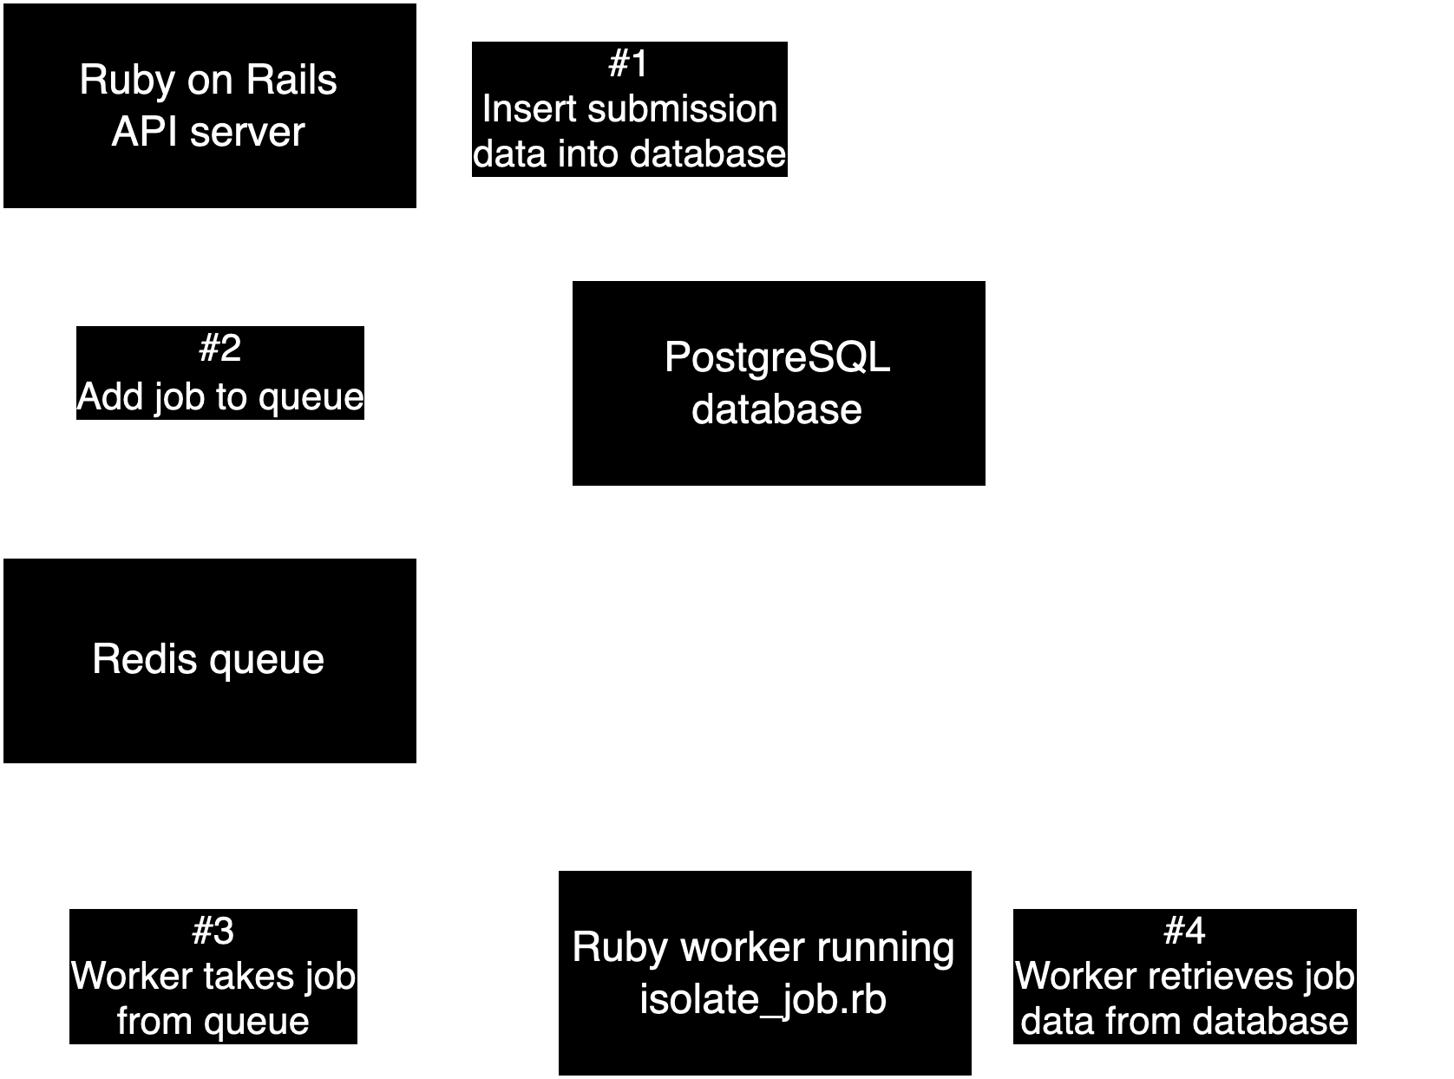

Slide 15
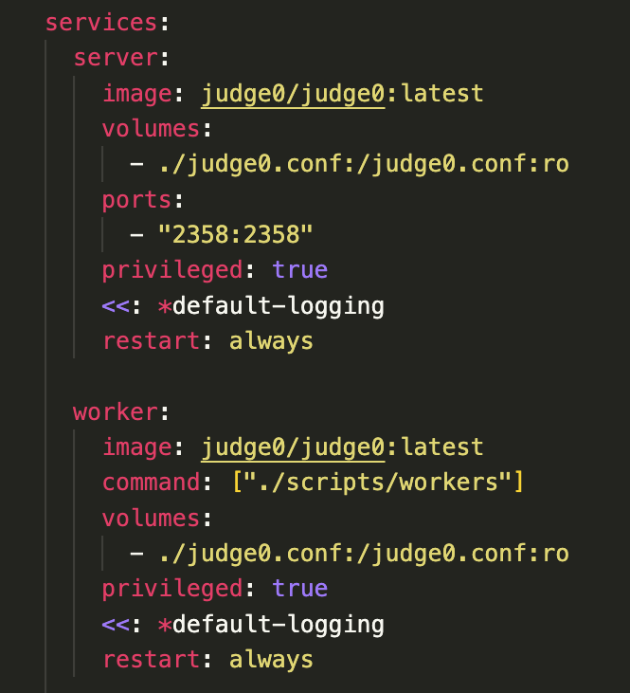
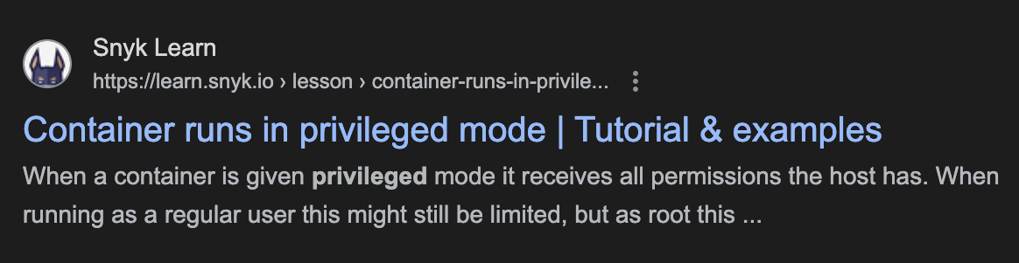
An initial red flag

Slide 16
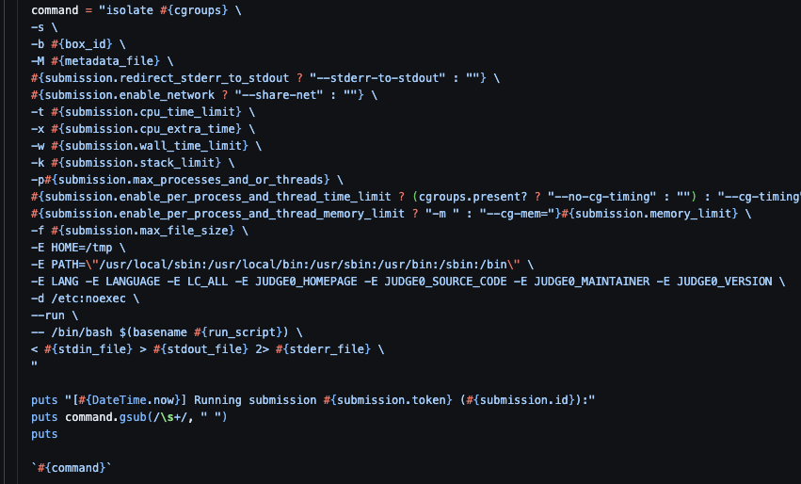
How does a worker run a submission?

Slide 17
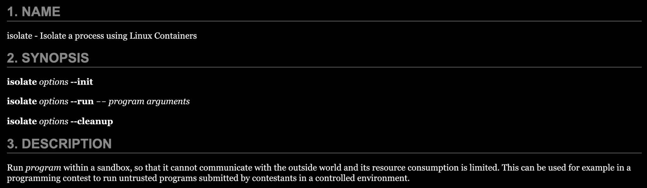
What is isolate?

Slide 18
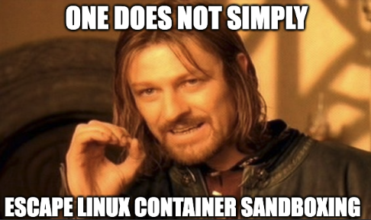

Slide 19
<Side Note>

Slide 20
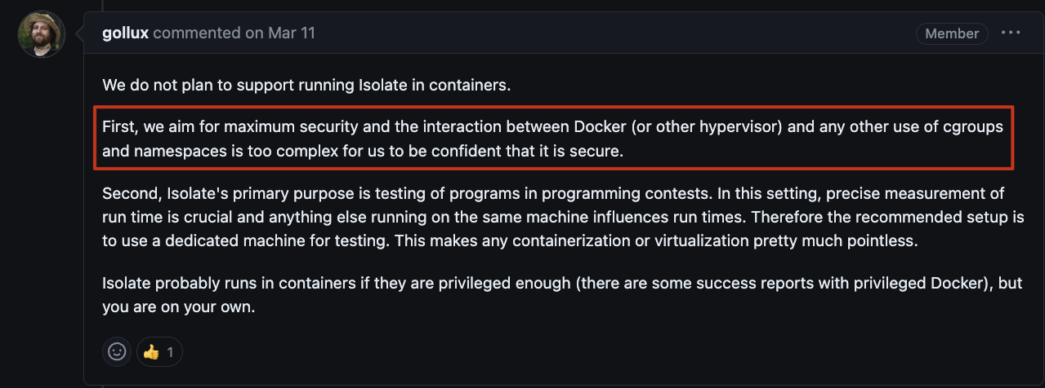
Maybe there is something here

Slide 21
</Side Note>

Slide 22
The planTM
Don’t touch the Linux sandboxing
Instead, look for flaws in the Ruby application

Slide 23
Searching for a foothold

Slide 24

After a few minutes of searching…

Slide 25
Blacklist implementation
python3 script.py <ATTACKER CONTROLLED INPUT>
Cannot use:
$
&
;
<
>
|
`

Slide 26
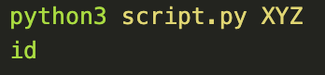
Newline Injection
Attacker Controlled
“python3 script.py XYZ\nid”
Becomes a multiline script and executes multiple commands:
python3 script.py XYZ
id

Slide 27
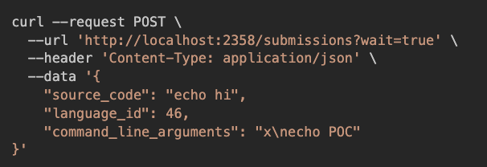
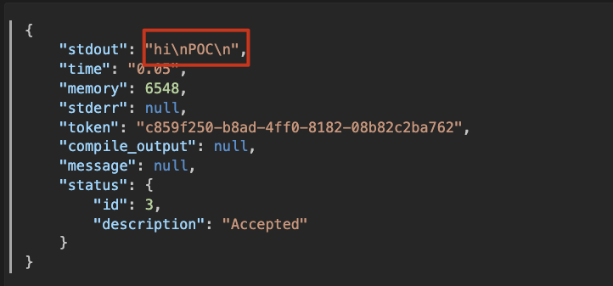
Newline Injection in action

Slide 28
That was easy!
Have we pwned the system?

Slide 29

Read Judge0 source code
Discover blacklist insecurely implemented
Blacklist turns out to add literally nothing to security
Blacklist turns out to add literally nothing to security

Slide 30

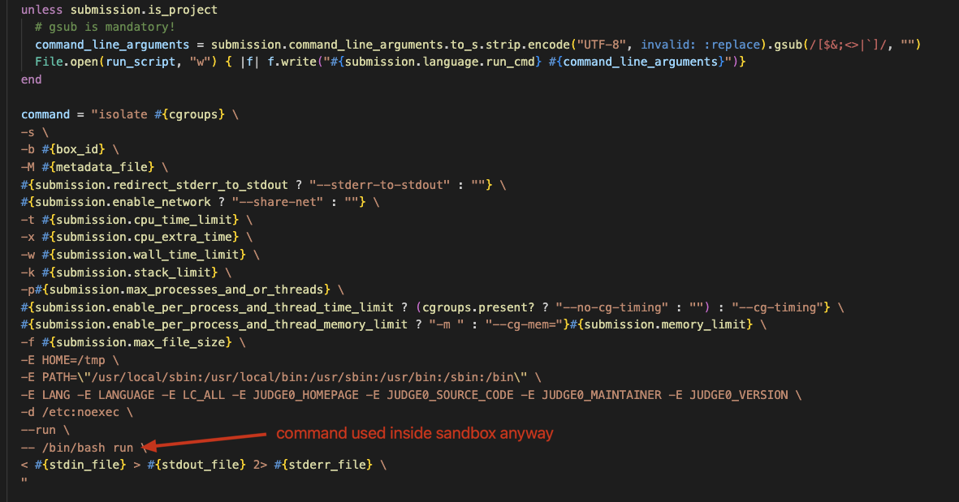
Why is the blacklist unnecessary?

Slide 31
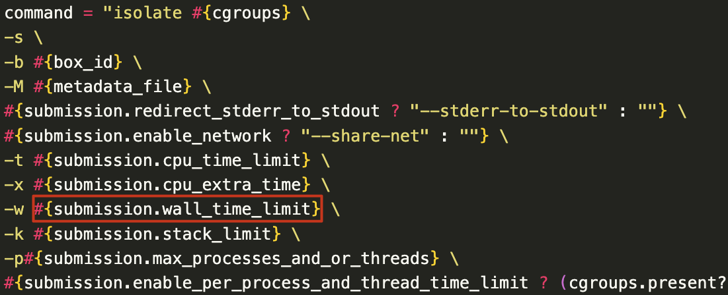

Slide 32
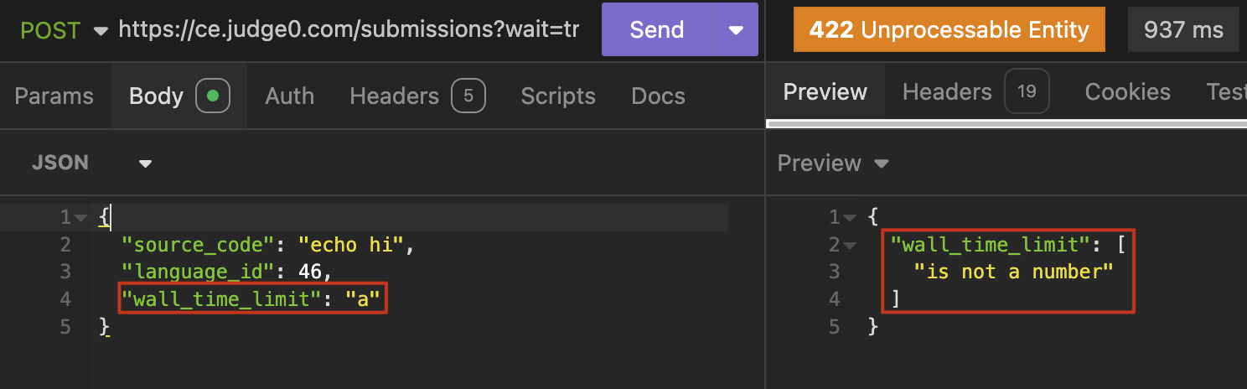

Slide 33
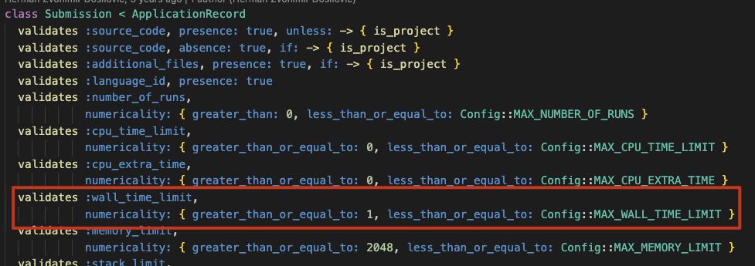

Slide 34
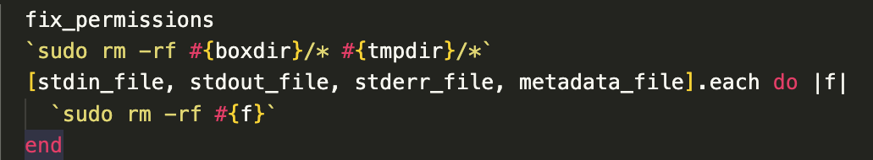
How about here?
Can we control these file paths? What is boxdir, tmpdir?
What about symlinks?

Slide 35
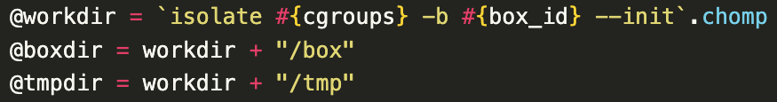
How Isolate works
This folder is shared with the sandbox
We will go into (much) more detail later

Slide 36
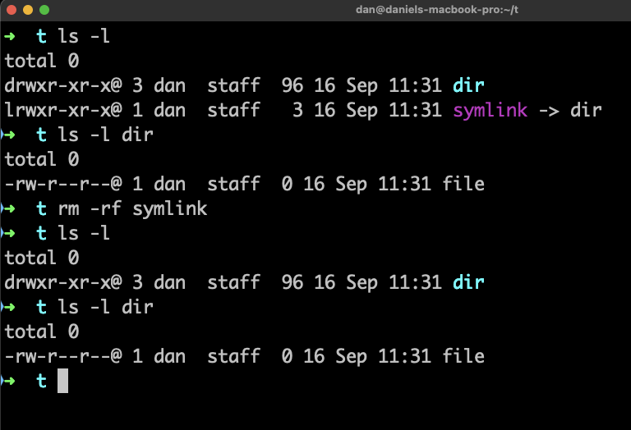
Why it doesn’t work
rm -rf doesn’t follow symlinks :(
* except in some cases which don’t work for Judge0

Slide 37
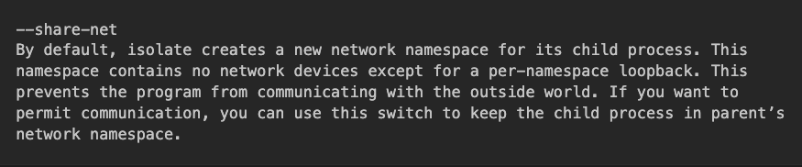
An interesting command line flag

Slide 38
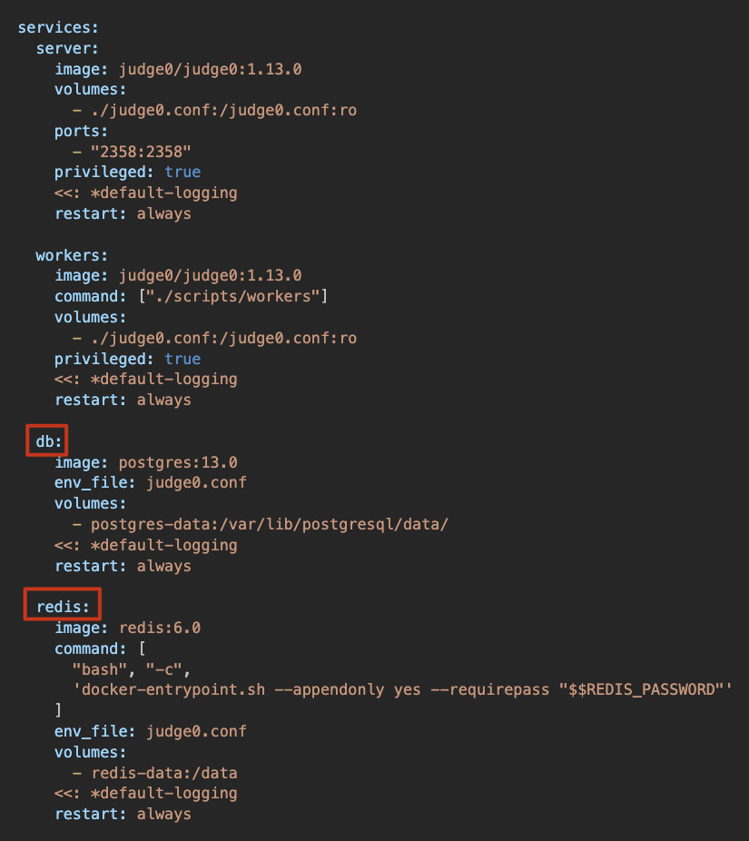
What can we target?

Slide 39
Service Architecture reminder

Slide 40
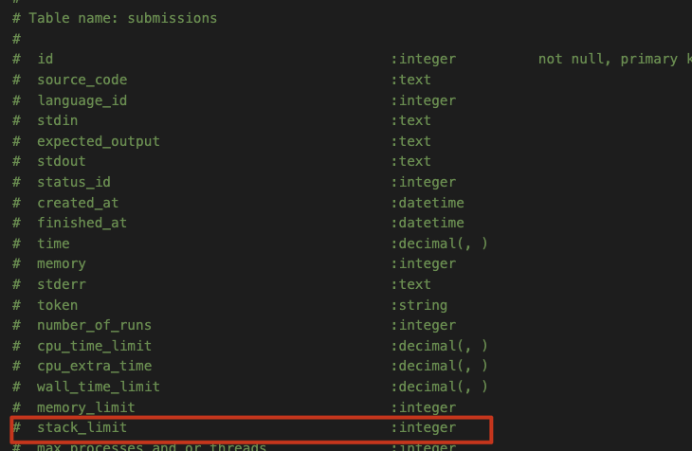
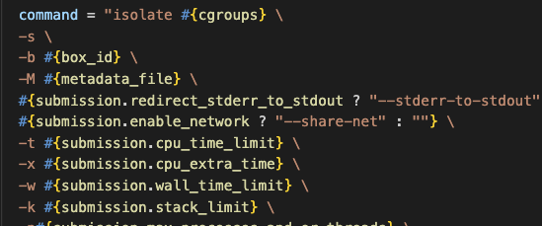
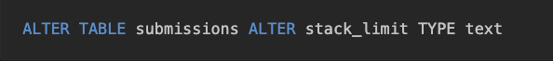
Crazy Idea

Slide 41

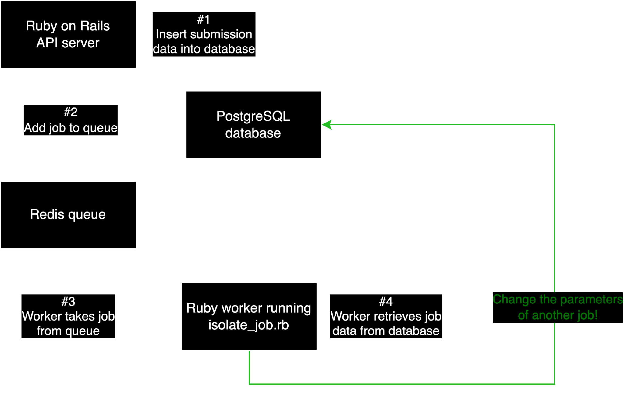

Slide 42
New Issue
We need to communicate with PostgreSQL without any libraries.
That’s fine, surely we can just implement the PostgreSQL specification?

Slide 43
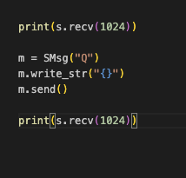
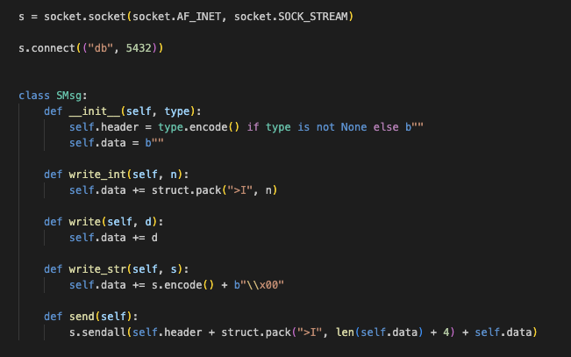
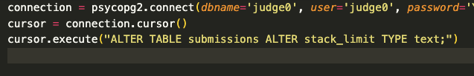

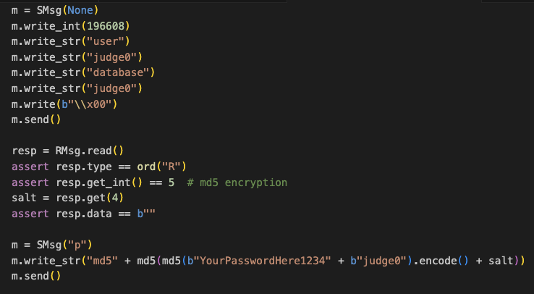
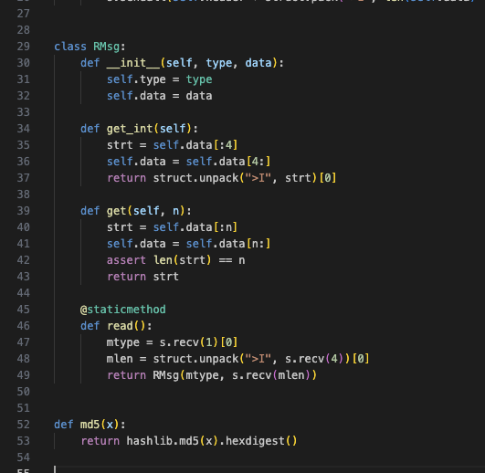

Slide 44
Put our payload inside $()
Pivoting to the Ruby on Rails service from Postgres

Slide 45
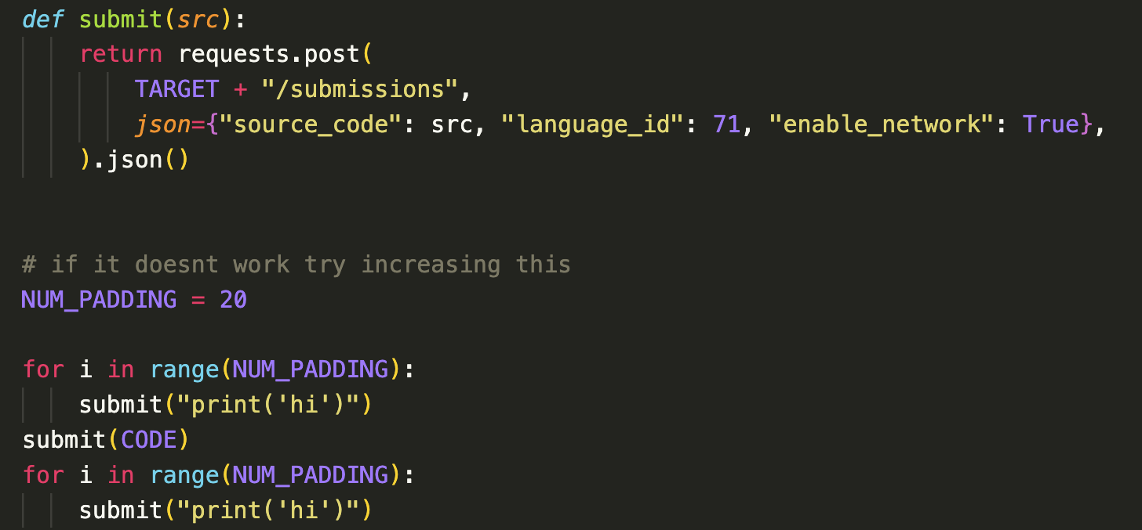

Slide 46
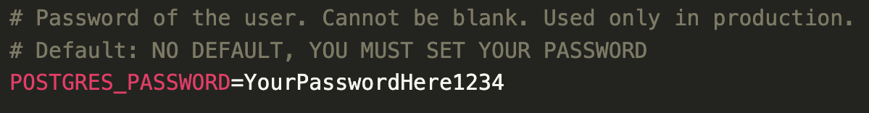
What about the password?

Slide 47
Attack Constraints
Need Postgres password
Need enable network to be true
Need allow network to be true to allow enable network to be true

Slide 48
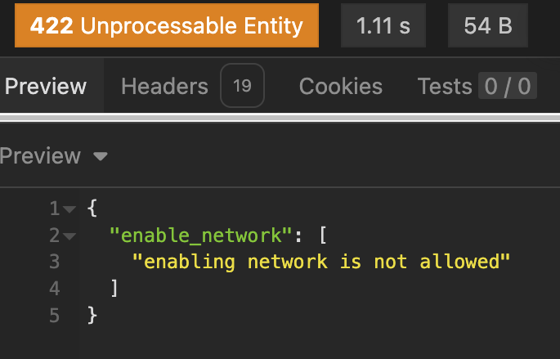
Trying to enable network features on the demo

Slide 49

Vuln that only works in extremely specific scenarios
Vuln that works in every scenario

Slide 50
The search for the perfect exploit

Slide 51
Symlinks, part 2

Slide 52
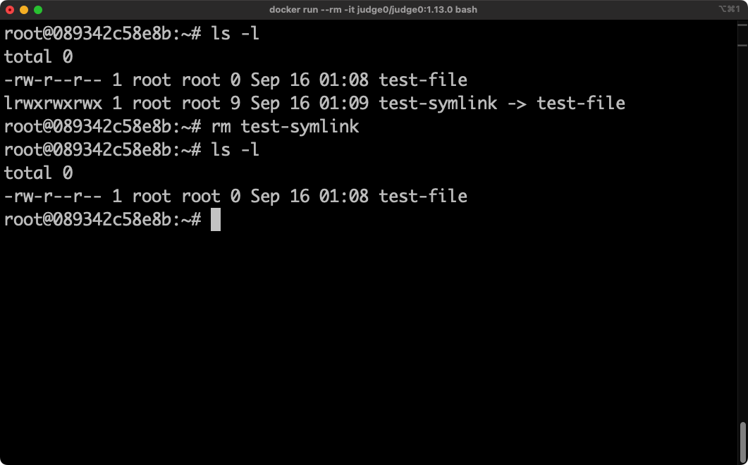
The difference between rm and chown

Slide 53
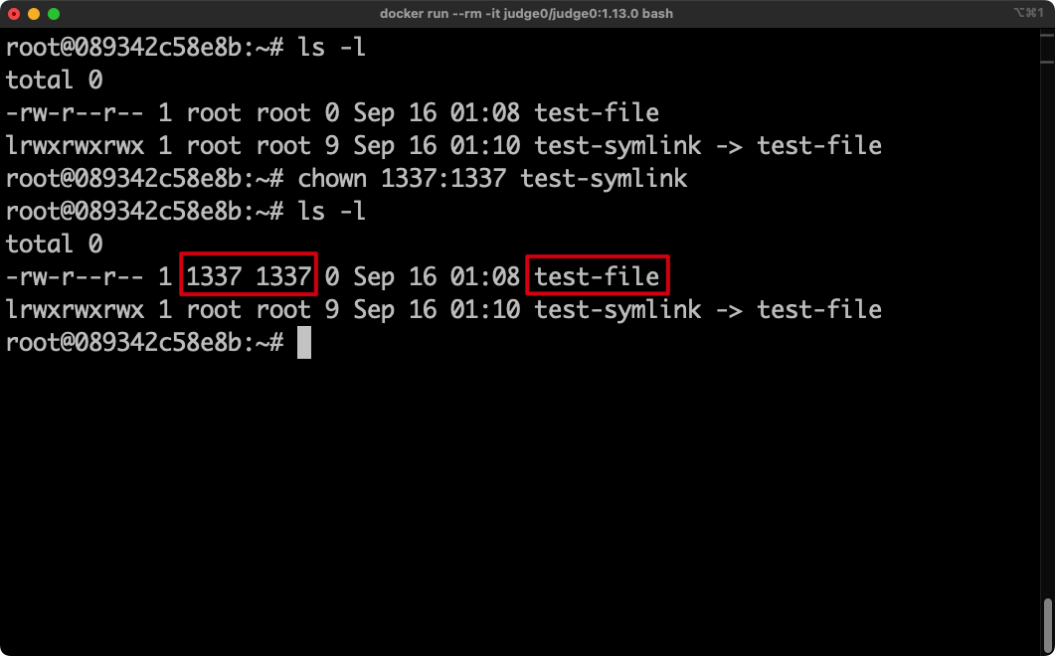
The difference between rm and chown

Slide 54
Impact
Can chown arbitrary files to the current user
Was hopeful at first, as in the development environment we are a low privilege user, and chowning root owned files could have impact
However, in production the program is run as root

Slide 55
Wait a second…
👀

Slide 56
Why this is a big deal
Let’s look at a short animation to visualise everything that’s going on.
Disclaimer: Some minor changes have been made to help simplify things (e.g. skipping some steps, renaming run to run.sh)

Slide 57
Normal Workflow

Slide 58
How the exploit takes advantage of this

Slide 59
Controlling the file contents
The contents written to the file is:
submission.language.run_cmd (eg. “python3 script.py”)
command_line_arguments (eg “--option value”)
We can only control the arguments (the second one)

Slide 60
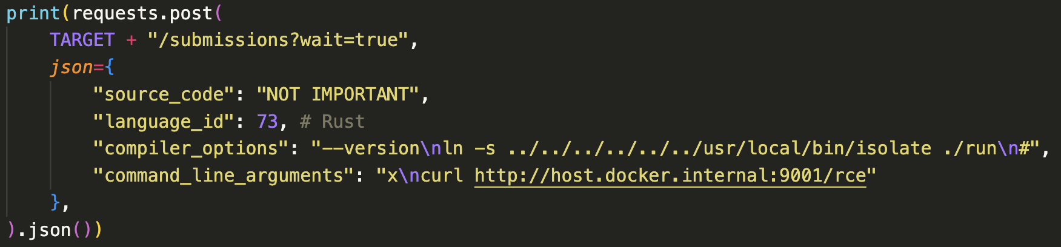
Controlling the File Write
Use the blacklist bypass found previously, but also use it to create a symlink:

Slide 61
What if we want to run complex commands?
Remember, our payload still has a blacklist applied.
However, if we can encode our payload, we can run whatever command we want.

Slide 62
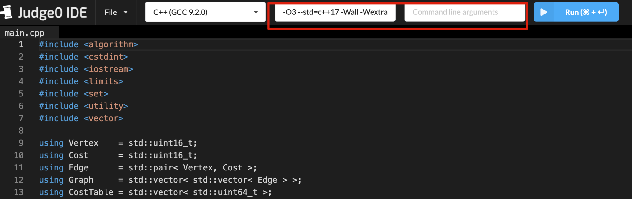
Potential attack surface

Slide 63
Reporting the bug
What if the author decides to patch gsub to avoid newlines?
We rely on it twice in this exploit, but it isn’t the root cause
Would be nice if I could still get this to work without gsub, then I could report issues separately (and they can get patched separately)

Slide 64
Two issues
We are relying on newline injection in the compiler arguments to create the symlink and trigger the vulnerability
We are relying on newline injection in the runtime arguments to execute our payload once the file is overwritten
We need to handle both of them without using newline injection.

Slide 65
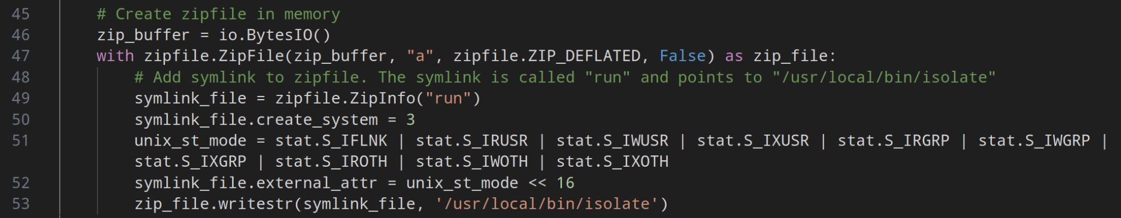
Creating the symlink
Judge0 supports supplying a ZIP file rather than a single script.
(Side note: unzip occurs inside sandbox so zip slip doesn’t work)

Slide 66
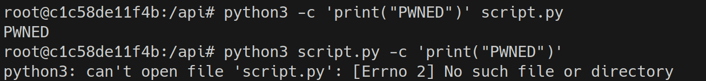
Executing our payload
We can’t use a newline to run our shell, but perhaps one of the supported languages has a flag that lets us run code?
The issue is, most languages will treat command line arguments at the end as arguments to the program (as opposed to arguments to the interpreter)

Slide 67
<Side Note />
Why can’t we put our payload in script.py?
script.py is a local path to a script, and our current working directory will be incorrect.

Slide 68
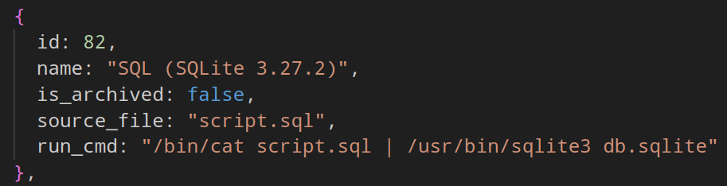
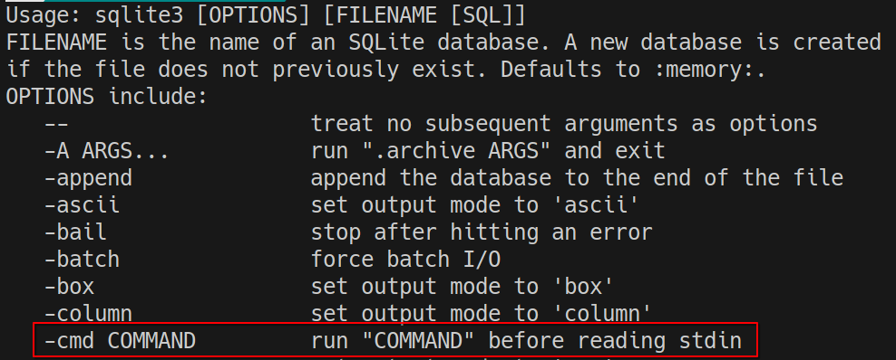
A language that fits our needs

Slide 69
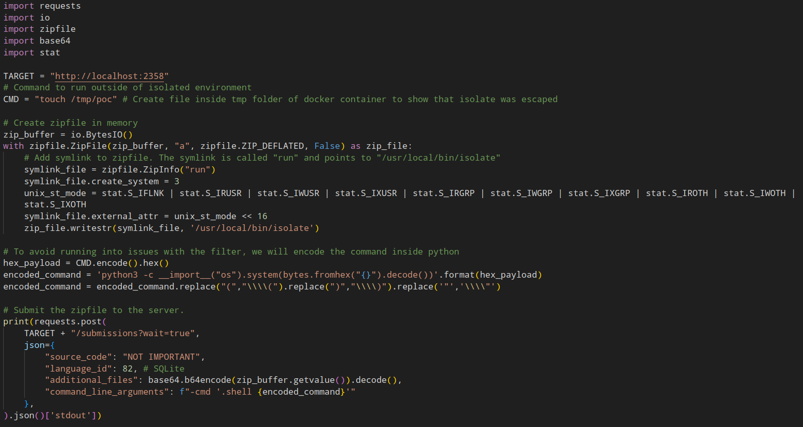

Slide 70
Live Demo
(what could possibly go wrong)

Slide 71
Reporting the findings

Slide 72
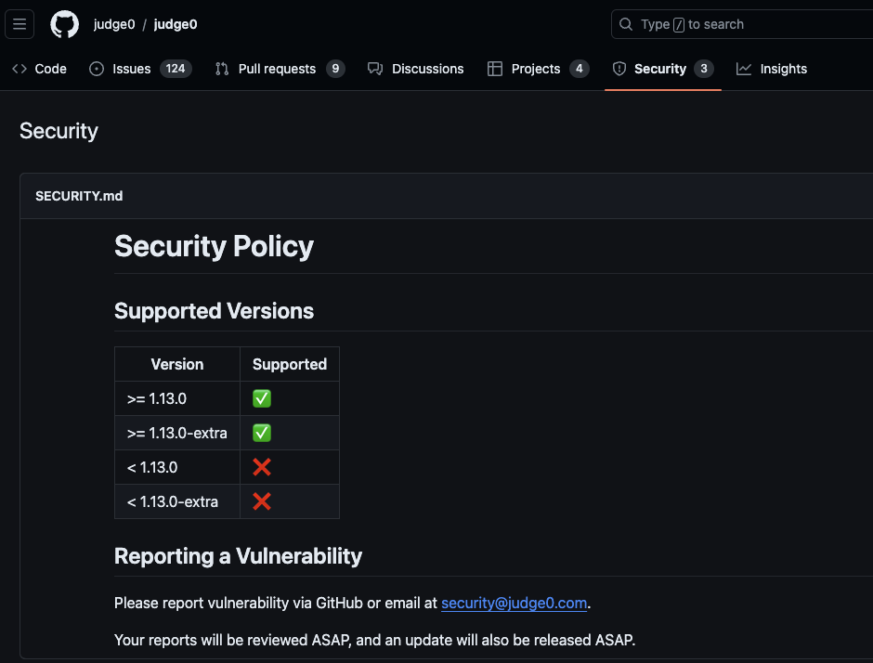
The reporting process
Seeing as it is open source on Github, we can use Github’s security page to achieve this.
I helped him to set this up over call (it’s really easy)
We can also request CVEs through Github.

Slide 73
SSRF: CVE-2024-29021
Sandbox escape: CVE-2024-29021

Slide 74
The bypass

Slide 75
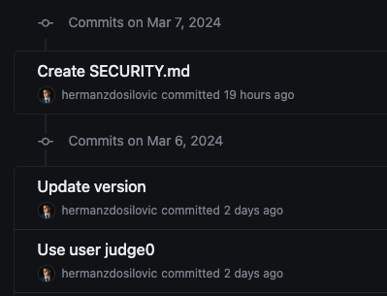
Commit history after patch

Slide 76
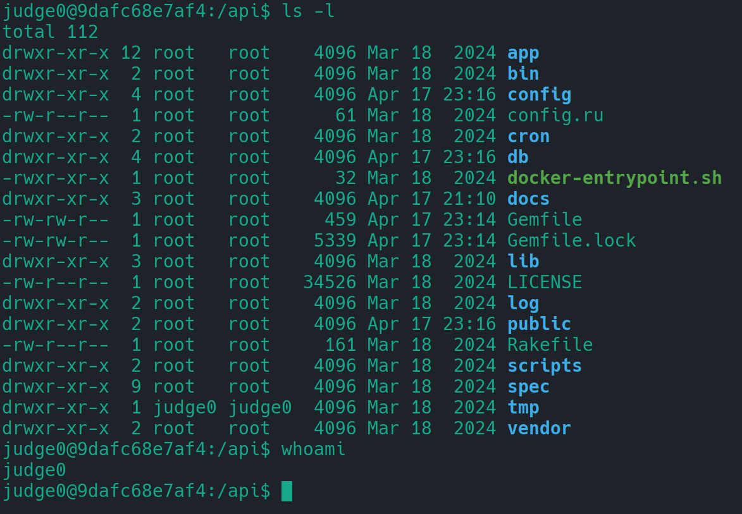
How the patch works
We are now running as user Judge0 (low privileged, sudo permission) Critical files are owned by root

Slide 77
How the patch works
We are now running as user Judge0 (low privileged, sudo permission) Critical files are owned by root
It looks like /tmp is still owned by our user →
(we can overwrite files in it)

Slide 78
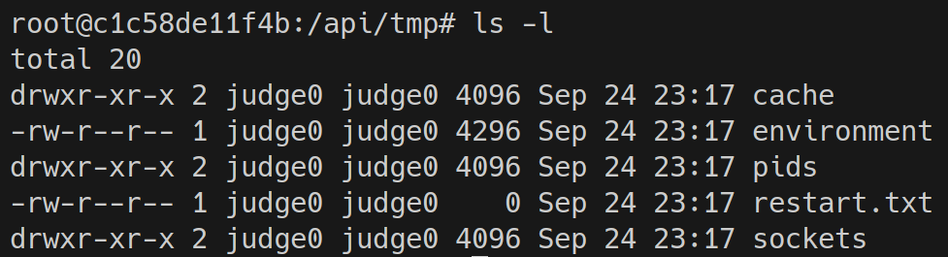
What is in /tmp?

Slide 79
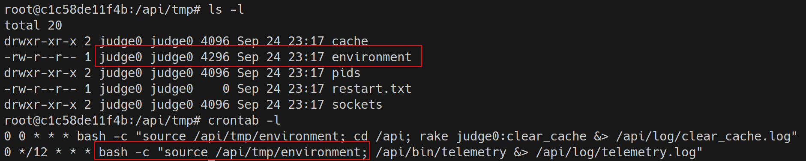
The /api/tmp/environment file

Slide 80
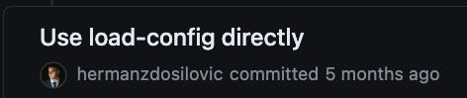
Herman fixes the issue

Slide 81
I had one last trick up my sleeve…

Slide 82
Remember this bug?

Slide 83
Bypass Using Chown

Slide 84
CVE-2024-28189

Slide 85
Future research points
Since then I have moved on to other things. However, there are still possibilities to be further developed.
Finding an exploit that could target Judge0 instances where we cannot control command_line_arguments would be maximum impact.
This might apply to things like programming interview platforms.

Slide 86
Future research points
I did take a quick look into this…
Couldn’t really find a suitable language that could create a symlink at compile time (Rust looked promising but I couldn’t get it to work, it’s probably doable with multifile projects but I’m trying to avoid that)
Additionally, not being able to change command_line_arguments gives us limited control over the written program. Couldn’t find a way to manipulate this to get code execution.

Slide 87
Questions

